Slide 1
Growing Courageous Leaders An overview of Diversity, Equity and Inclusion Initiatives coordinated by the Massachusetts Interscholastic Athletic Association (MIAA) and Massachusetts School Administrators’ Association (MSAA)

Slide 2
Overview
Utilize interscholastic athletics as a platform that promotes behavior change that supports the respectful treatment of all members of a school community.
Pilot Training Program NFHS Implicit Bias Course, MIAA Diversity, Equity & Inclusion Pledge, MIAA Discriminatory Incident Report Form
Regional Trainings 13 Regional Events
Resource Guide History, programs, resources, partnerships and sample communications

Slide 3
Resource Guide

Slide 4
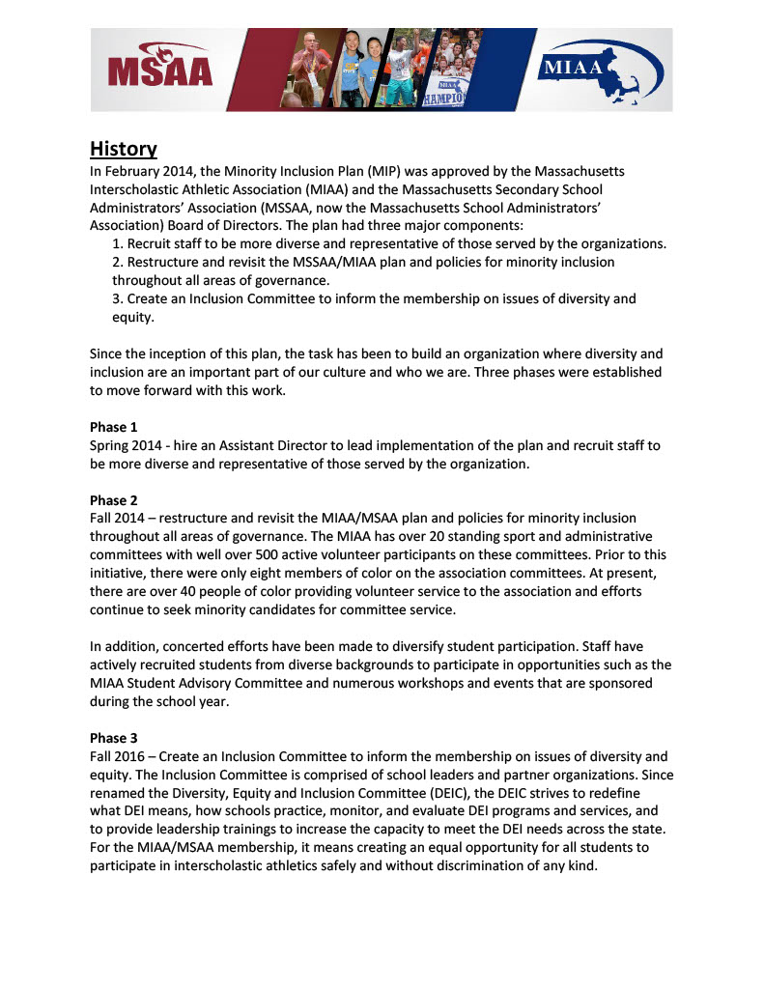
Resource Guide
History Overview of steps following approval of the Minority Inclusion Plan (MIP) by the MIAA Board of Directors.
Phase 1 – Staff
Phase 2 – Membership/Governance
Phase 3 – Diversity, Equity & Inclusion Committee

Slide 5
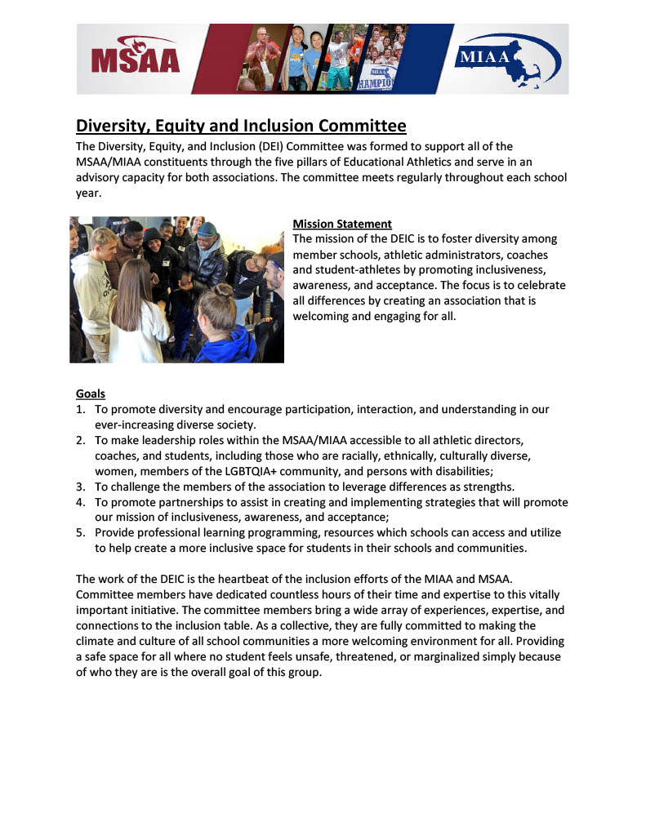
Resource Guide
Diversity, Equity & Inclusion Committee
Overview
Mission Statement
Goals

Slide 6
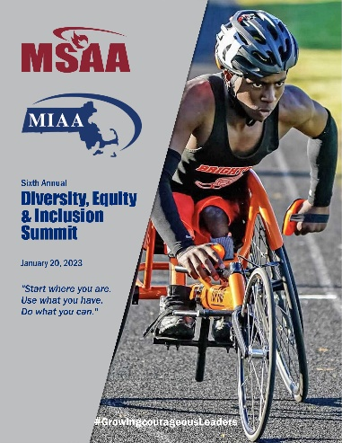
Resource Guide
Programs Overview and history of events
Diversity, Equity & Inclusion Summit
Diversity, Equity & Inclusion Symposium
-Links to programs
-Themes
-Workshop descriptions
-Speaker contact information

Slide 7
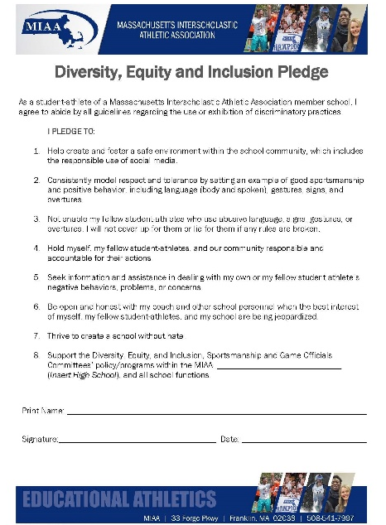
Resource Guide
Pilot Program Approved by MIAA Board of Directors
NFHS Implicit Bias Course
MIAA Diversity, Equity & Inclusion Pledge
MIAA Discriminatory Incident Report Form
* Sample message to membership

Slide 8
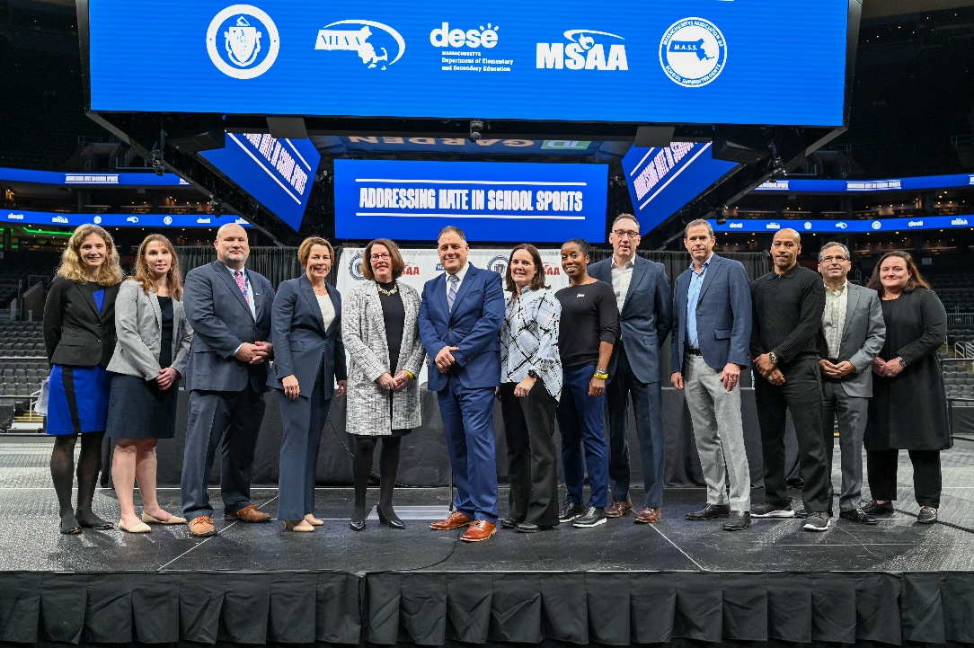
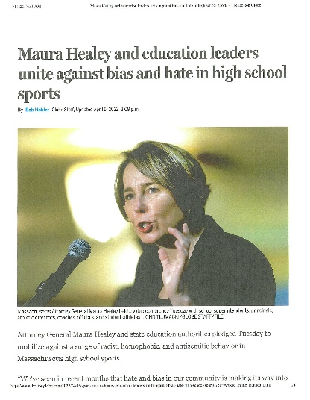
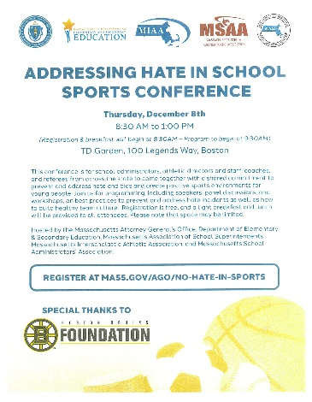
Resource Guide
Regional Trainings Addressing Hate and Bias in School Athletics
A Call to Action (April 2022)
Kickoff Event (December 2022)
Regional Trainings (Spring 2023)
-Resources
-Sample Communications
-Partnerships

Slide 9
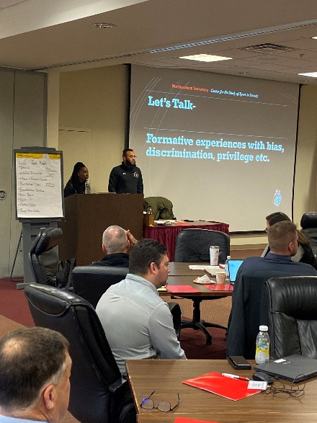
Resource Guide
Regional Trainings 13 Events
Two ½ days (Friday and Saturday)
Superintendent, Principal and Athletic Director
Train-the-trainer model
-Resources
-Sample Communications
-Partnerships

Slide 10
Resource Guide
Partnerships and Resources Partner organizations and helpful tools
MIAA/MSAA Diversity, Equity and Inclusion Webpage
MIAA/MSAA Guidelines for Starting a Diversity, Equity and Inclusion Club
A Guide for Responding to School Sports-Related Bias Incidents
Attorney General’s Office Guidance for School Athletic Staff on Hate Incidents

Slide 11
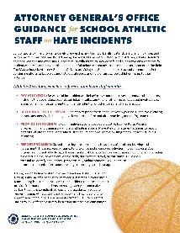
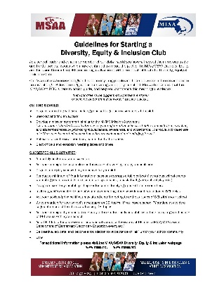
Resource Guide
Partnerships and Resources Partner organizations and helpful tools
MIAA Diversity, Equity and Inclusion Pledge
MIAA/MSAA Discriminatory Incident Report Form
School Sports and Bias: Best Practices and Resources for Athletic Directors, Coaches and School Administrators
Attorney General Office’s Guidance on Schools’ Legal Obligations to Prevent and Address Hate and Bias Incidents/Resource List for Schools

Slide 12
Next Steps

Slide 13
Thank You

